Slide 1

Eugene Teo
@eugeneteo / https://eugeneteo.net http://www.meetup.com/PyData-SG/

Slide 2

Thanks Alyssa!

Slide 3
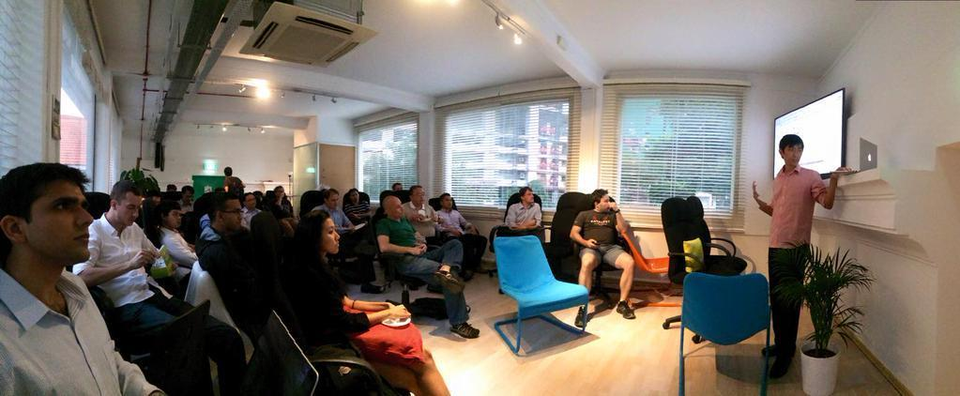
PyData 1
Thanks Alyssa (again!), Kai Xin, Martin, Asankhaya, and Shubham!

Slide 4
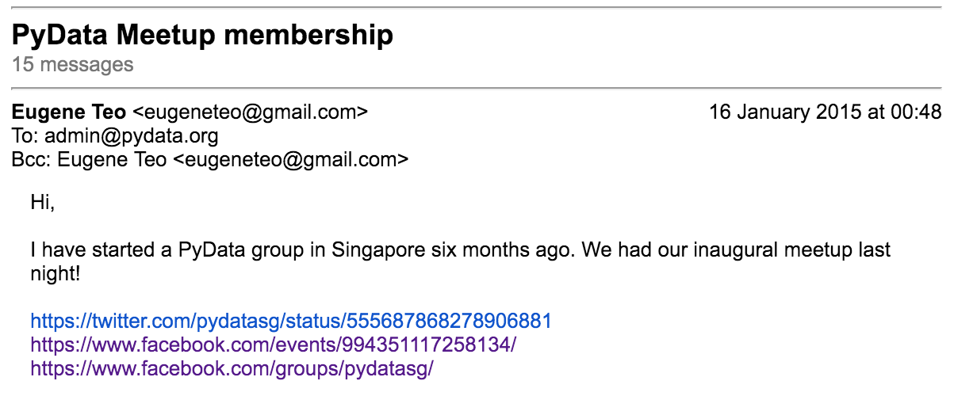

Slide 5
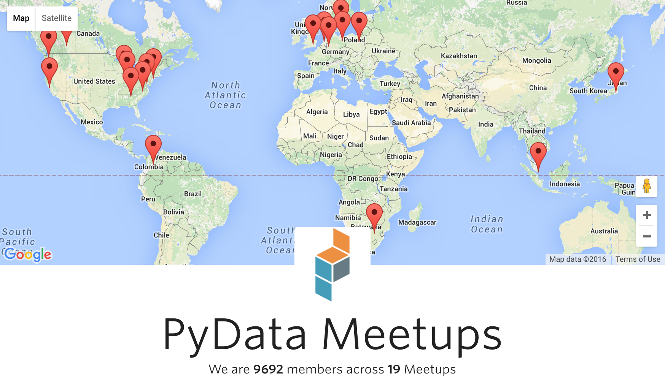

Slide 6


Slide 7
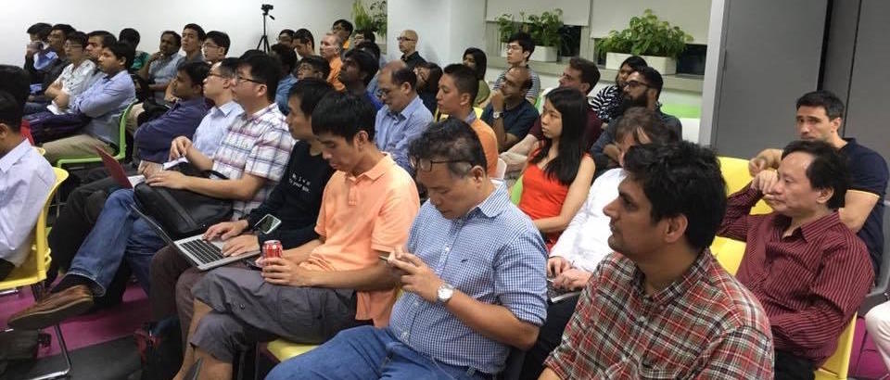
PyData 6

Slide 8
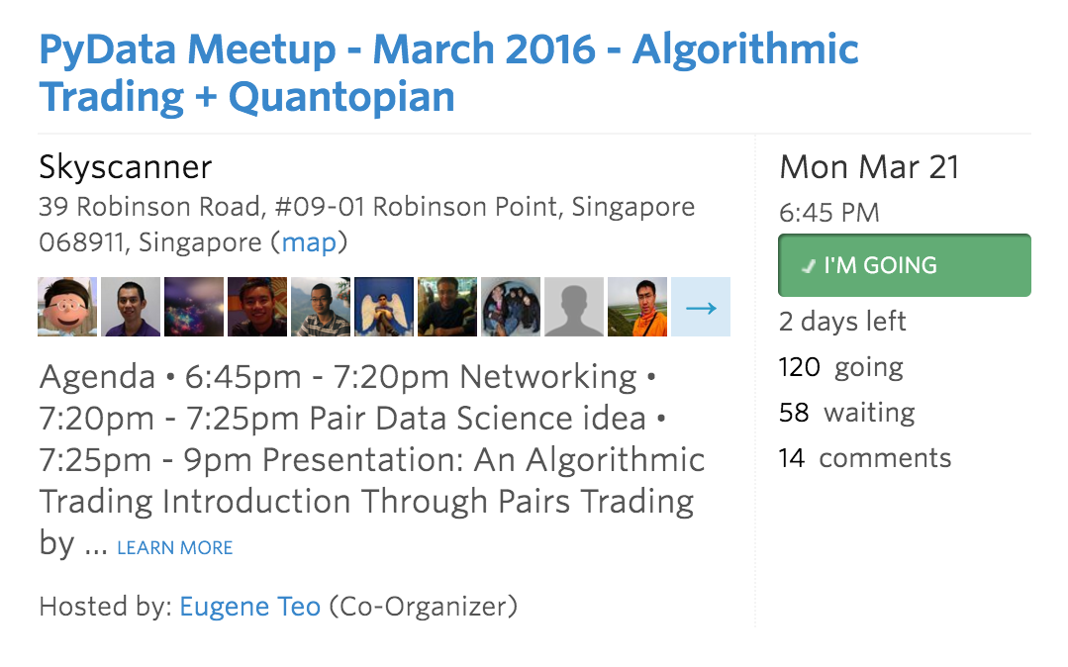
PyData 7 next Monday!

Slide 9
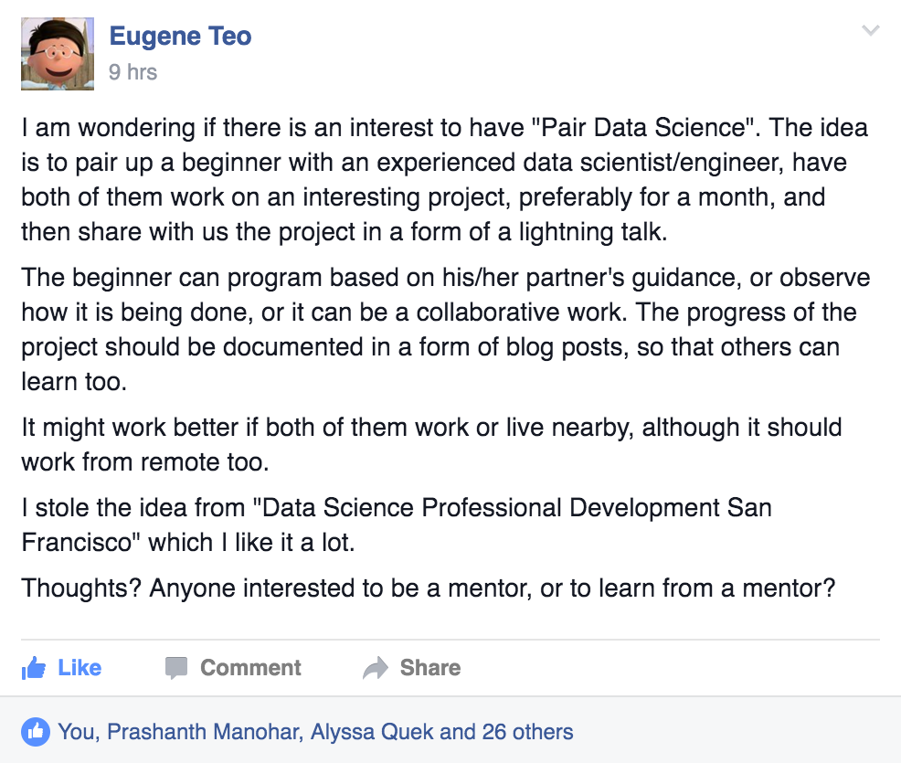
Next Steps?

Slide 10
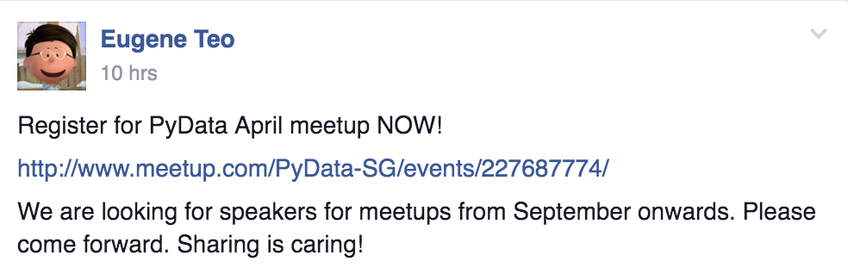
Next Steps?

Slide 11

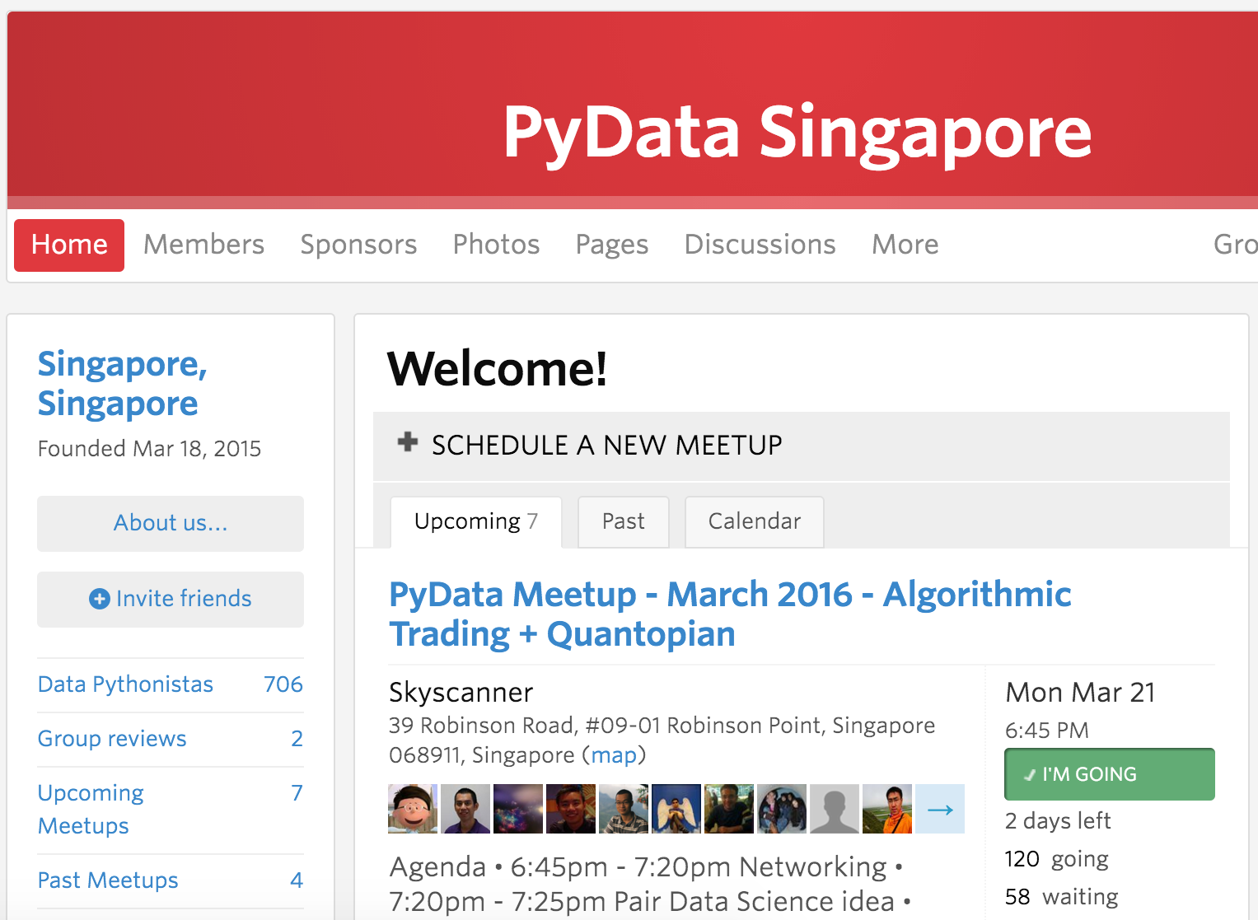

http://www.meetup.com/PyData-SG/

